Slide 1
COASTANCE
Komotini 27 March 2012
Coastal Flooding phenomena in the Region of Eastern Macedonia Thrace (REMTH) in relation to Climate Change
Nikos Kotsovinos
Michalis Aftias
Ydronomi Consulting Engineers

Slide 2
The objective of this presentation is : a)discus the parameters involved in predicting coastal flooding in vew of the climatic change b)discus the problems of the present state of the art in modelling coastal flooding c)determin future Coastal flooding risk in REMTH in the light of climate change .

Slide 3
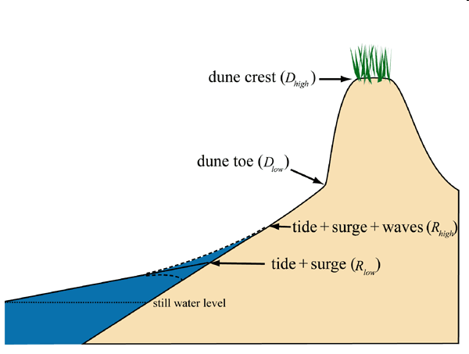
The max inundation level depends on the superposition of a) still water level, b) tide c) surge and waves runups .
Source: Harry C. Friebel, U.S. Army Corps of Engineers Philadelphia District

Slide 4
We usually think that Climate change is responsible for increasing mean temperature.
However recently (SOURCE : I. R. Young*, S. Zieger, and A. V. Babanin , (2011), Global Trends in Wind Speed and Wave Height , Science ,Vol. 332 ,no. 6028 , pp. 451-455) , it has been documented that climatic change is also responsible for increasing extreme wind speed.

Slide 5
SOURCE : I. R. Young*, S. Zieger, and A. V. Babanin , (2011), Global Trends in Wind Speed and Wave Height , Science ,Vol. 332 ,no. 6028 , pp. 451-455
Climate change increases extreme wind speed,so that:
Higher wind speed increases storm surge , i.e. elevation of sea water level
Higher wind speed increases the height of surface gravity waves , i.e. increases Run-up elevation

Slide 6
For the Mediterranean Sea , where astronomical tide is small ( about ±20 cm ) , extreme flood potential of coastal areas depends on the superposition of the following three factors which are exposed to climatic change :
Storm surge (climatic factor: increase of wind speed extreme)
Large Wave run-up ( climatic factor : increase of wave height which depends on the wind speed extreme)
Mean sea level rise (MSLR) ( climatic factor : temperature increase )

Slide 7
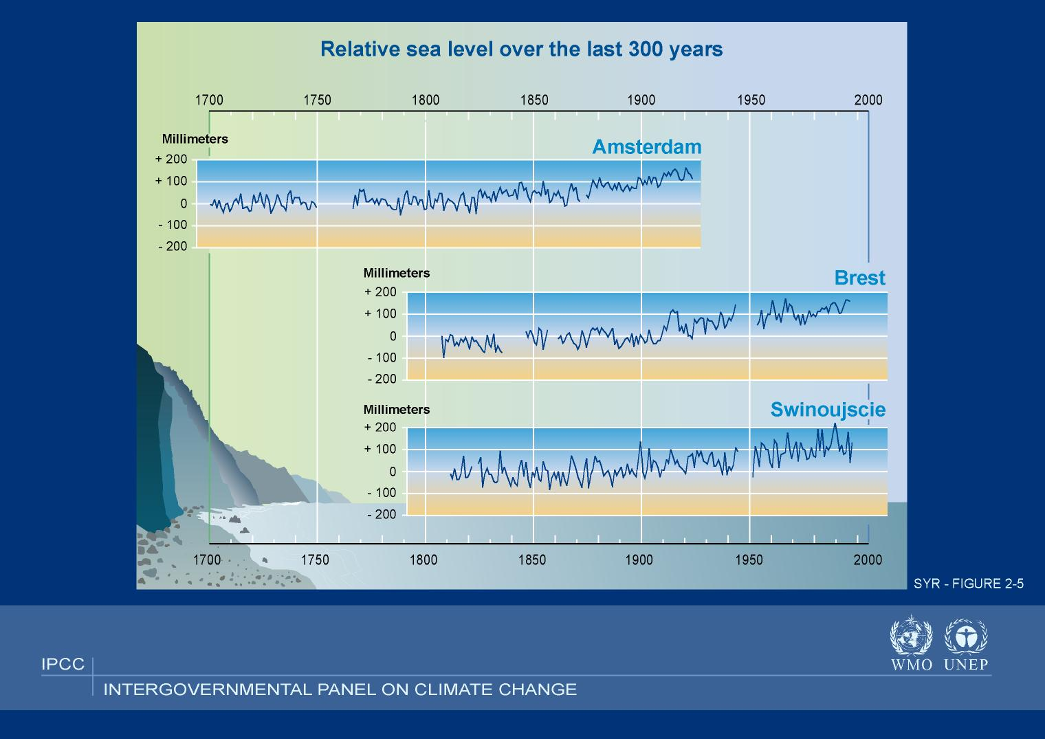

Slide 8
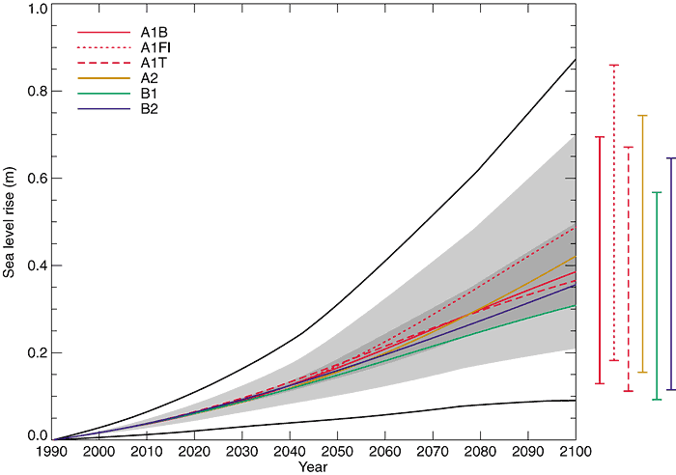
Global sea-level rise
Intergovernmental Panel on Climate Change (IPCC)
Include uncertainty
in ice parameters
All models-Special Report on
Emissions Scenarios (SRES)

Slide 9
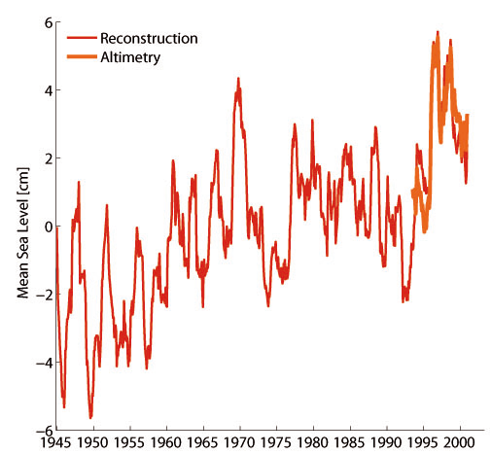
Mediterranean mean sea level trends of the past decades from tide gauge and altimetry fields (1945-2000)
(source Damià Gomis 2008)

Slide 10
Worst-case scenario for Mean Sea level rise in 2100 (end of century) :
Global model : sea water level is projected to rise by 59 to 88 cm , but with significant regional variations
IT IS WRONG TO ASSUME THE IPCC PREDICTION TO MEDITERRANEAN SEA
Mediterranean Sea (downscale model) : sea water level rise by 35 cm ( i.e. half for the value given for global sea water level rise)

Slide 11
Storm Surge
The storm surge is an increase in the water level that is pushed towards the shore by the force of the winds.
Worst-case scenario in 2100 (end of century) :
Storm surge increase about 65 to 95 cm for the 100-year return period at Alexandroupolis port at North Aegean,see Tsimplis at al (2009).
The climatic change will increase this value, but on the basis of the available data, is not possible to quantify the increase .

Slide 12
At the end of century in REMTH :
A combination of storm surge and sea level rise can raise the sea water level (SWL) by an additional 1.39 to 1.88 meters.

Slide 13
100- year design values of significant wave height Hs (Source: Wave and Wind Atlas of the Hellenic Seas, Sept. 2007, Hellenic Center of Marine Research)
The 100-year design values of significant wave height (Ηs) for North Aegean(REMTH coast ) is about 8 m .

Slide 14
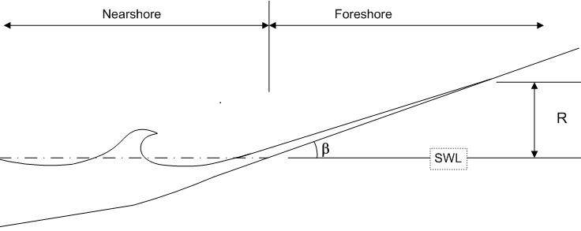
  WAVE RUN UP MODELLING USING CEDAS OR OTHER EMPIRICAL MODELS
The available empirical equations to calculate wave run up assume a single, planar beach slope extending inland , an assumption which in practice is often violated either due to physical causes ( i.e. erosion which produces an abrupt front ) or due to human interventions ( construction of roads, structures etc).

Slide 16
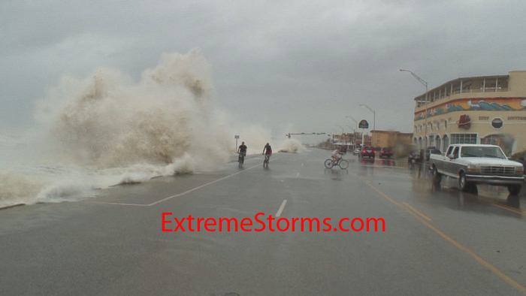

Slide 17
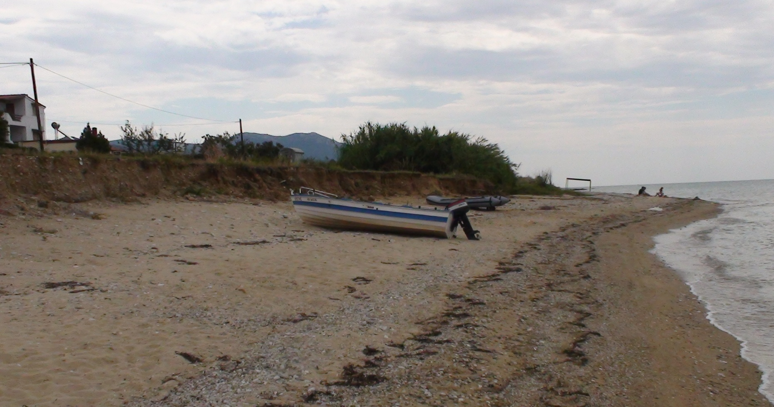
Erosion produces an abrupt front which modifies the inshore movement of wave run up (photo : Kariani, REMTH)-The elevation of the front is about 3 m.The prediction for the max elevation of the wave runups(2%) for the extreme flood scenario at the end of century is about 5 m.
(photo : Kariani, REMTH)-

Slide 18
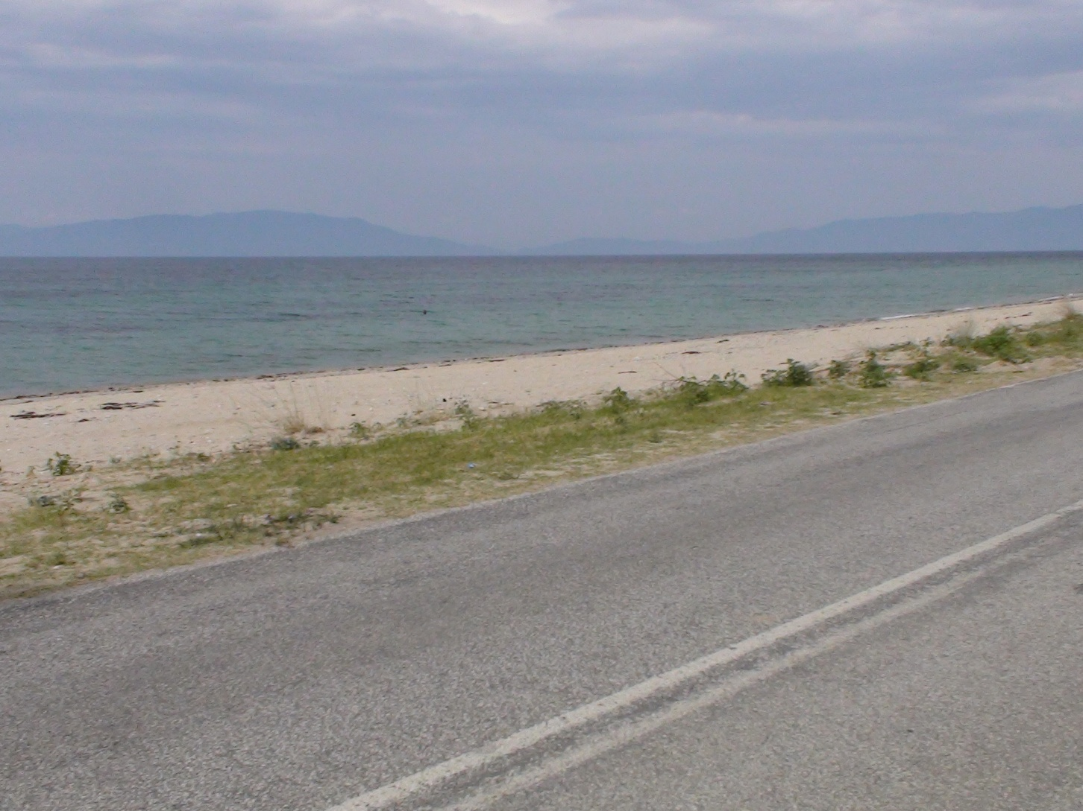
The elevation of the load is about 3 m.The prediction for the max elevation of the wave runups (2%) for the extreme flood scenario at the end of century is about 5 m.
(photo : Kariani, REMTH)-

Slide 19
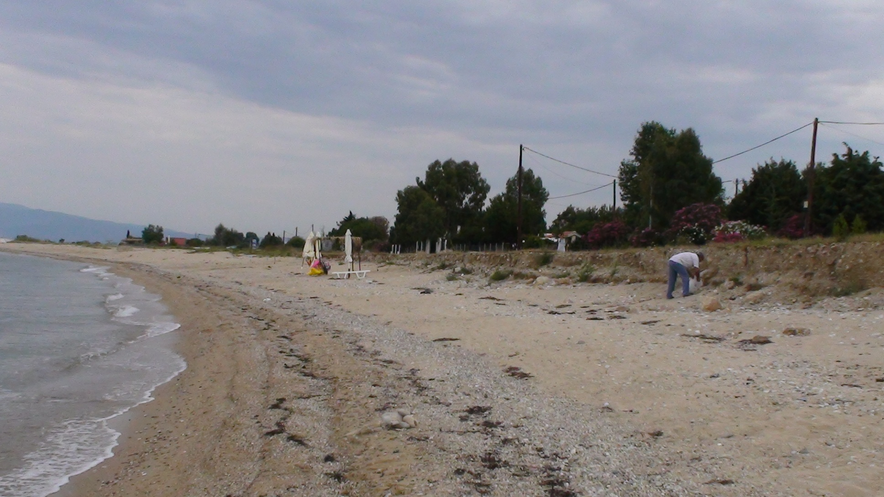
The abrupt front modifies the inshore movement of wave run up .The elevation of the front is about 3 m.The prediction for the max elevation of the wave runups(2%) for the extreme flood scenario at the end of century is about 5 m.
(photo : Kariani, REMTH)-

Slide 20
COASTAL FLOOD SCENARIOS
SCENARIO | ASTRONO-MICAL TIDE, m | SURGE, m | SEA LEVEL RISE, m | SEA LEVEL DUE TO TIDE, SURGE AND SEA LEVEL RISE ,m | Hs, m
A₁ | 0.2 | 0.65 (T=50y) | 0.35 (2100 max) | 1.20 | 7 (T=50y)
C₂ | 0.2 | 0.47 (T=1y) | 0.15 (2100 min) | 0.82 | 3.3 (T=1y)
D₁ | 0.2 | 0.65 (T=50y) | 0 Present | 0.85 | 7 (T=50y)
D₂ | 0.2 | 0.47 (T=1y) | 0 Present | 0.67 | 3.3 (T=1y)

Slide 21
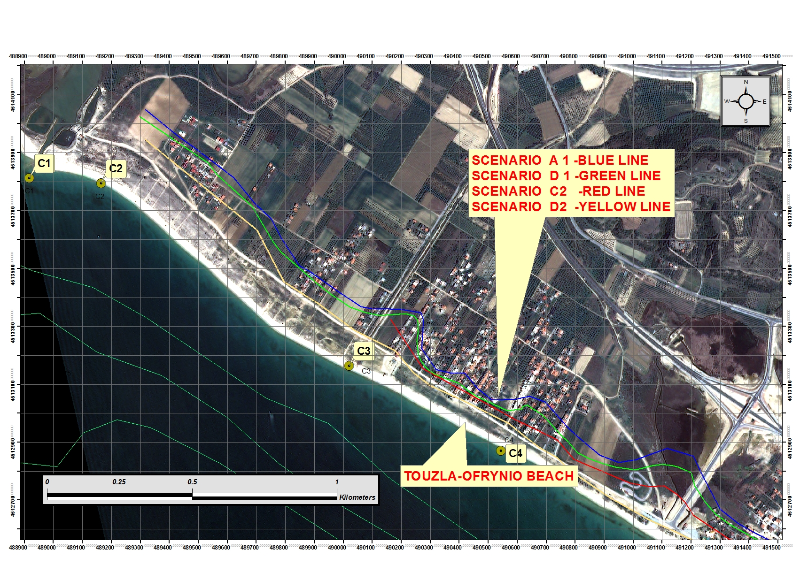
Flood Hazard Maps of Pilot Site

Slide 22
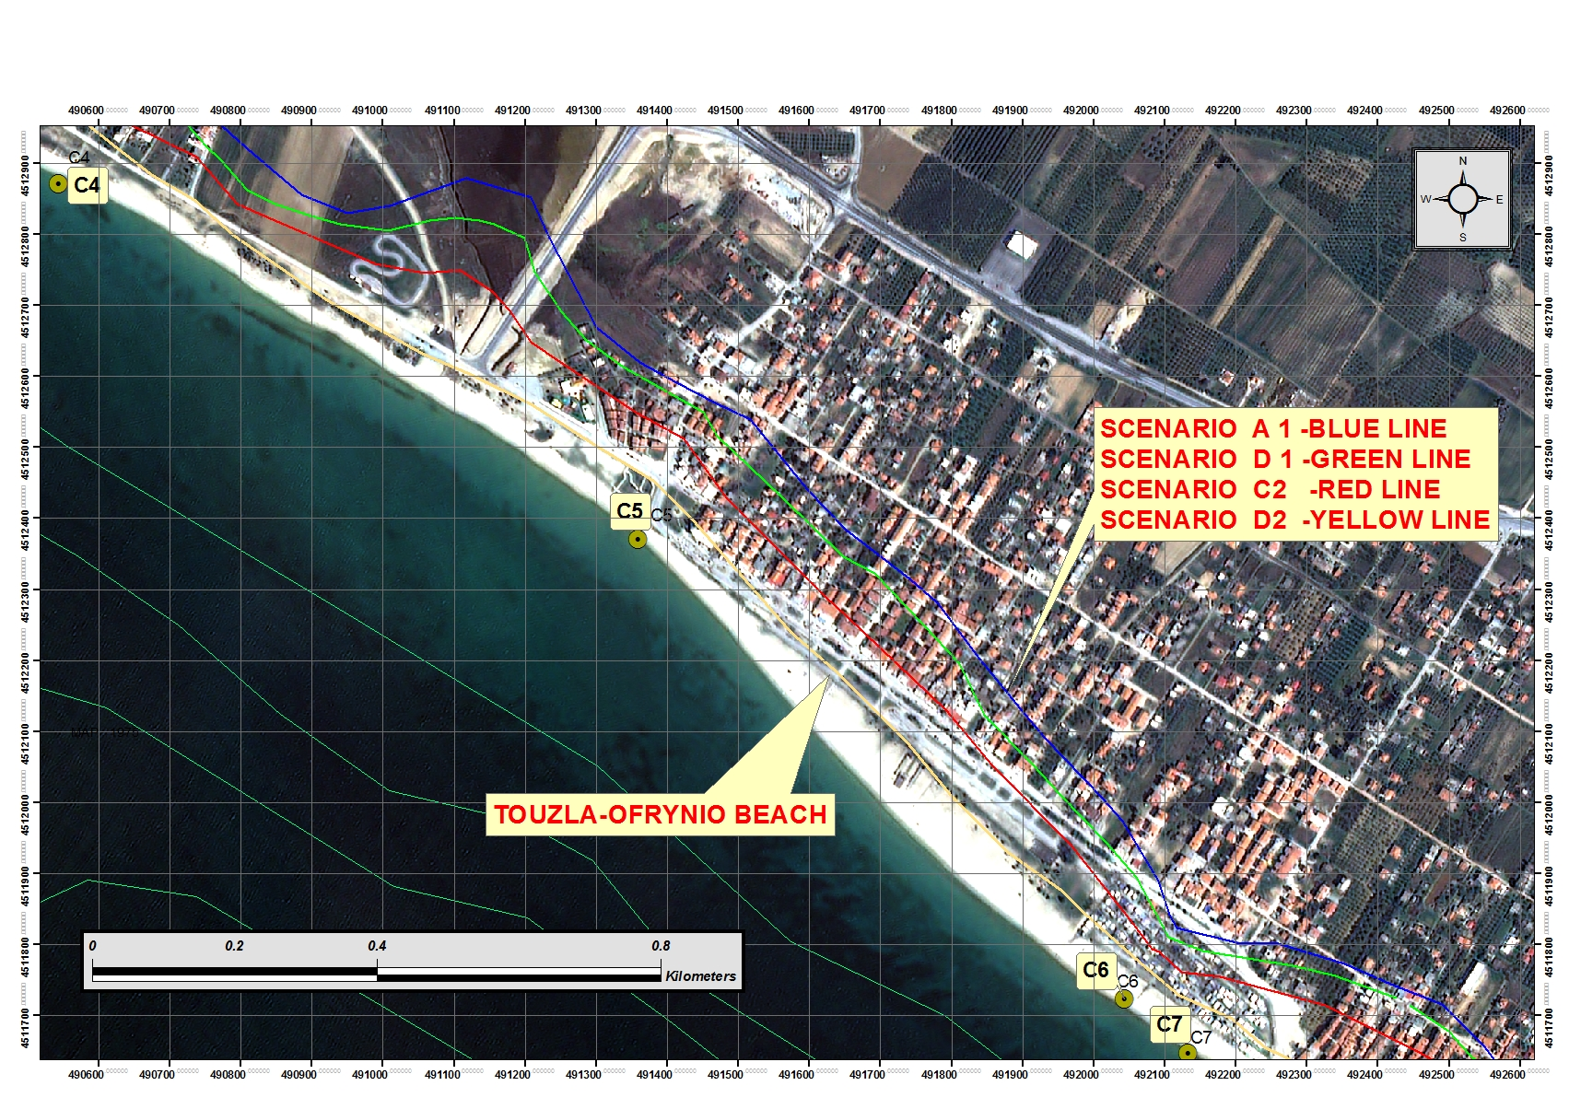
Flood Hazard Maps of Pilot Site

Slide 23
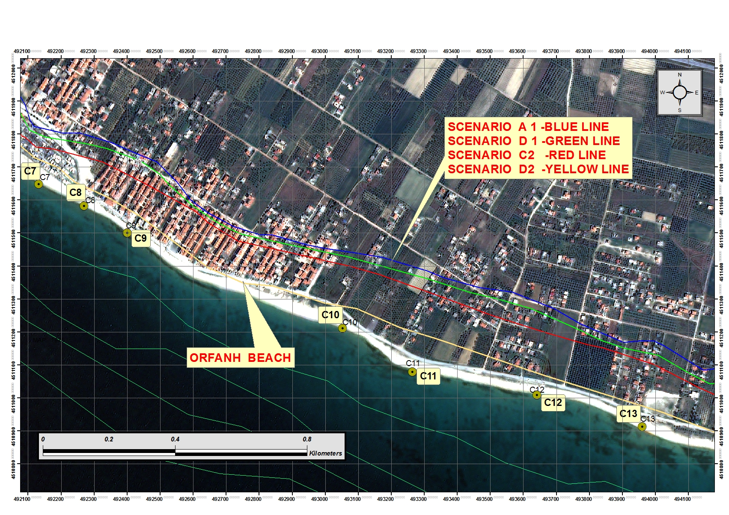
Flood Hazard Maps of Pilot Site

Slide 24
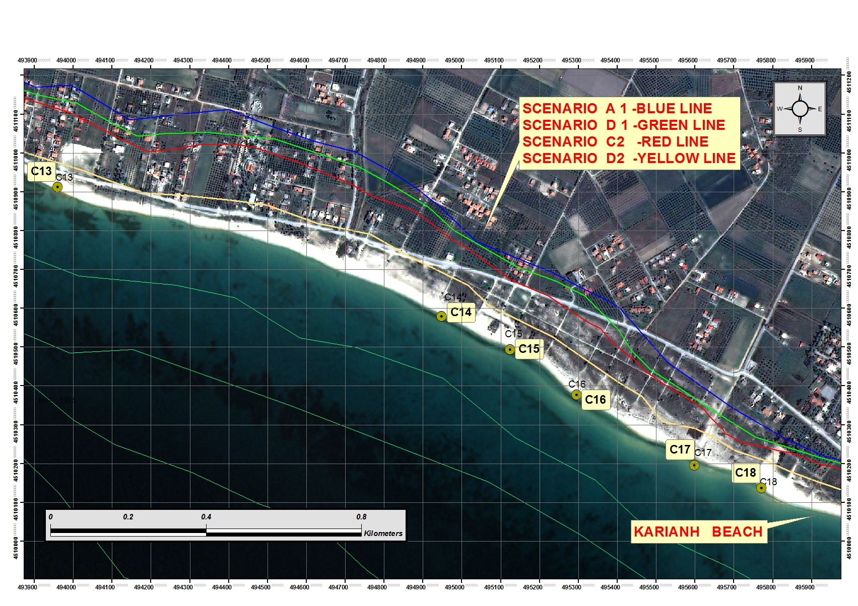
Flood Hazard Maps of Pilot Site

Slide 25
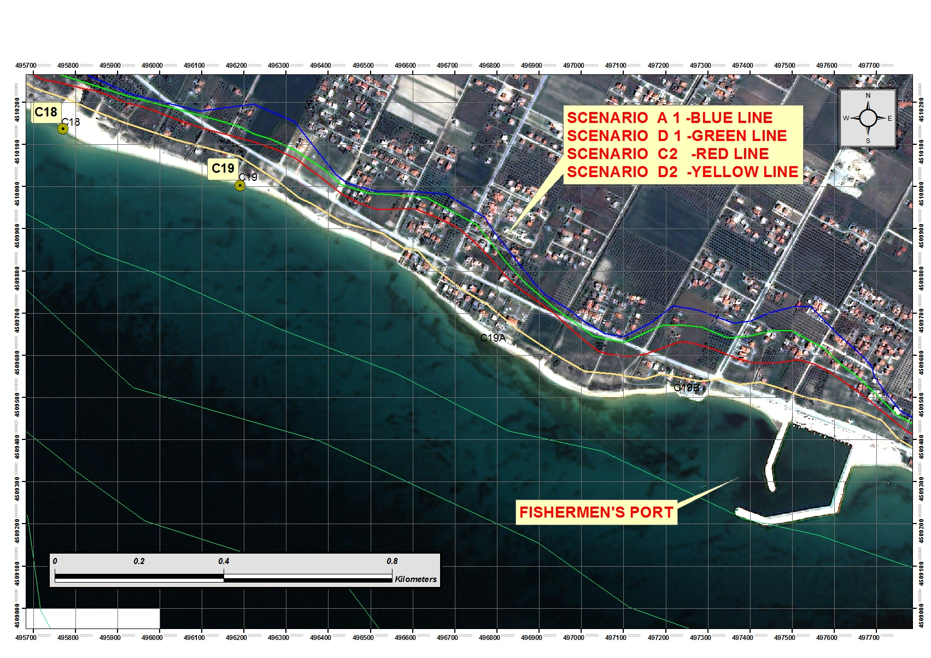
Flood Hazard Maps of Pilot Site

Slide 26
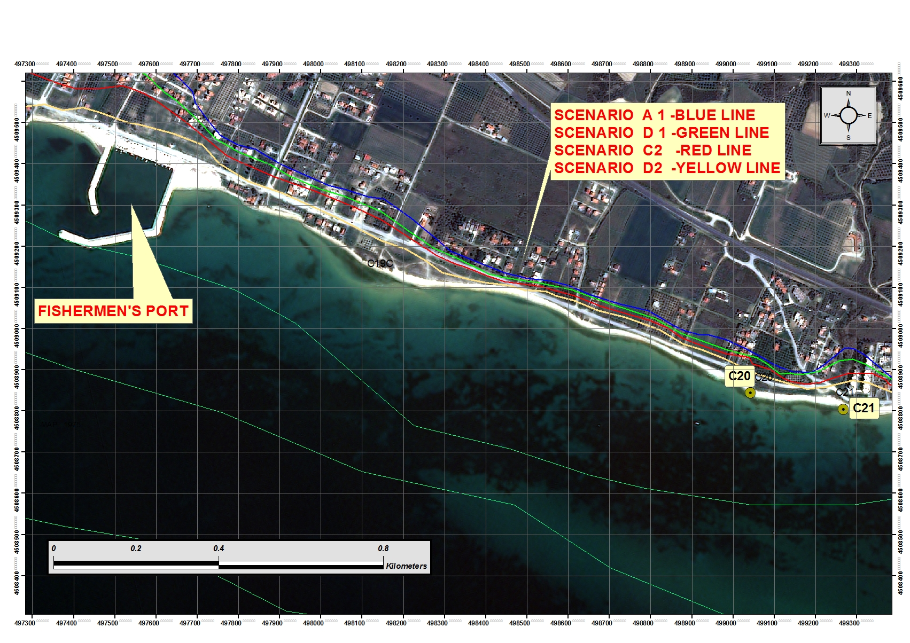
Flood Hazard Maps of Pilot Site

Slide 27
Flood Hazard Maps of Pilot Site
The existing methodology (CEDAS, Stockdon Equation etc) :
gives a conservative maximum “ instantaneous “ inundation level
can not predict the distribution and the residence time of water depth above the flooded land
identifies roughly the near shore land which has potential for flooding , keeping in mind that the empirical equations (including Cedas) overpredict considerably the horizontal distance inland of flooding due to wave runup .

Slide 28
The coastal flooding modelling of pilot site (REMTH, Kariani ) shows that disastrous events are expected at the end of century due to climatic change.

Slide 29
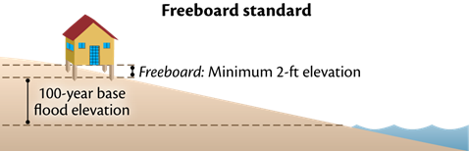
Develop protect, retreat, and abandonment policies for vulnerable coastal infrastructure
Adaptation Strategy: Elevate new and/or replacement structures 2+ feet above the current 100-year base flood elevation
(source :Zoë Johnson, Office for a Sustainable Future , Maryland , Dep. Of Natural Resources )
oë Johnson, Office for a Sustainable Future

Slide 30
The Flood Hazard Maps of Pilot Site contribute :
to the delivery of useful warnings to coastal communities and decision makers for the impacts of climate change risk
to inform on the need for further research on
climate change
to advocate the need for advanced 3D numerical modelling and understanding of wave run up in real topography .
Initiate sea level rise adaptation measures to reduce the region’s vulnerability to sea water level and storm rise .

