Slide 1
CARDIOVASCILAR ENGINEERING.
COMPUTATIONAL
FLUID DYNAMICS APPROACH
Johannes V. Soulis
B.Sc (Eng Sc), M.Sc (Mech Eng), Ph.D (Mech Eng)
Fluid Mechanics Professor
Fluid Mechanics Division, Faculty of Engineering,
Demokrition University of Thrace, Greece
e-mail: soulis@civil.duth.gr
www.soulis1.wixsite.com/mysite
December 2016
Thessaloniki, Hellas

Slide 2
Presenter
Johannes V. Soulis

Slide 3
Fluid Mechanics Division,
Faculty of Engineering,
Demokrition University of Thrace,
Hellas

Slide 4
CONTENTS
1) CARDIOVASCULAR ENGINEERING AND
COMPUTATIONAL FLUID DYNAMICS
2) PATIENT SPECIFIC ARTERY
3) NON-NEWTONIAN BLOOD
4) NORMAL LEFT CORONARY ARTERY
5) RIGHT CORONARY ARTERIES
5.1 RCA
5.2 Stented artery
5.3 Arterial wall
6) AORTA
7) FLUID STRUCTURE INTERACTION (FSI)
8) CONCLUSION

Slide 5
CHAPTER 1
CARDIOVASCULAR ENGINEERING AND
COMPUTATIONAL FLUID DYNAMICS

Slide 6
"Bioengineering" means the application of various disciplines of Engineering in living beings.
The Computational Fluid Dynamics approach has become very popular in recent years in Bioengineering Science with particular emphasis in Biomedical Engineering.
Computational Cardiovascular Mechanics is the science that deals with the computational analysis of the cardiovascular system and specifically with the diagnosis and treatment of cardiovascular disease.
Computational Fluid Dynamics is part of Computational Mechanics
Computational Cardiovascular Mechanics

Slide 7
Computational Fluid Dynamics & Atherosclerosis
Cardiovascular diseases, such as atherosclerosis, are major reasons for mortability and morbidity in the western world countries.
Although genetic factors seem to be important, basic mechanisms
related to arterial wall cell malfunction, which leads to atherosclerosis
formation, depend on the blood flow properties.
Computational Fluid Dynamics sheds light into blood flow.

Slide 8
Flow factors of great importance in
atherosclerosis genesis and progression
High or low oscillatory wall shear stress
Flow recirculation
Long residence time of atherogonous materials with the endothelium
Wall shear stress gradients
Local turbulence
Pressure

Slide 9
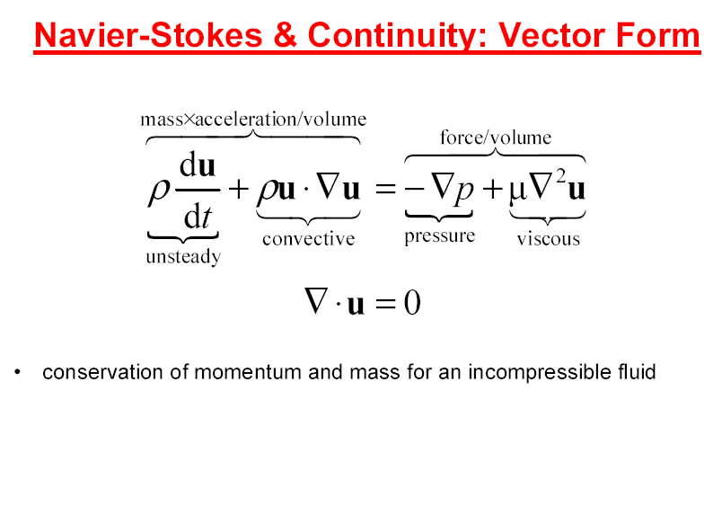
The Navier-Stokes equations govern the blood flow

Slide 10
The convection-diffusion equation

Slide 11
The flux diffusion equation

Slide 12
Shear stress

Slide 13

CHAPTER 2
PATIENT SPECIFIC ARTERY

Slide 14
Geometry, computational grid and flow equations for the patient specific arteries

Slide 15

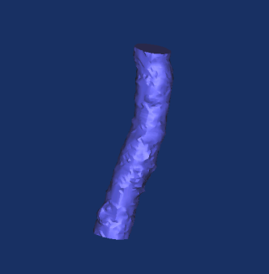

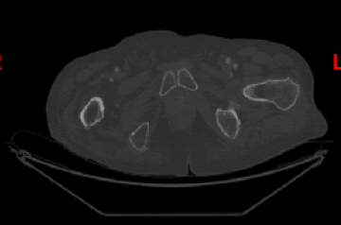
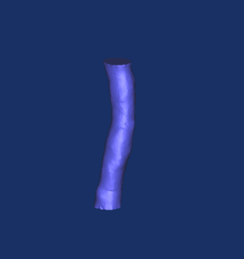

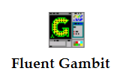
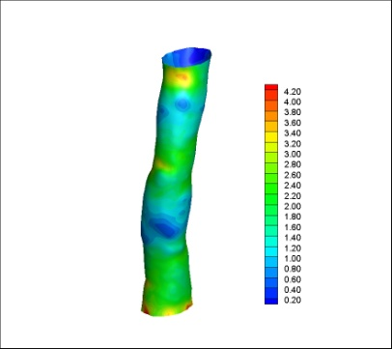
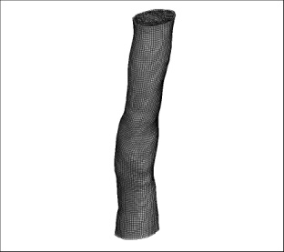

Applied Methodology
Coarse 3D geometry
2D digital images produced by a
Computed Tomography (CT) process
Smoothed 3D geometry
Computational Grid
Computational Results

Slide 16

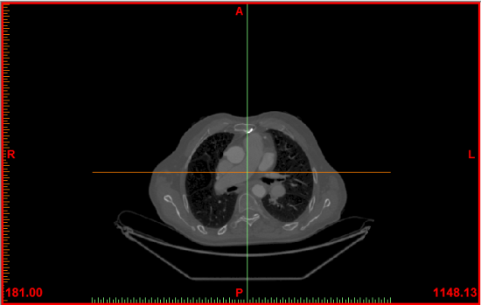
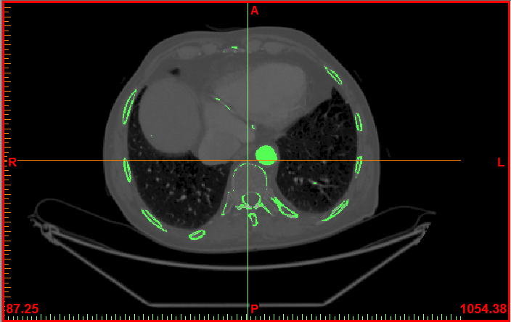
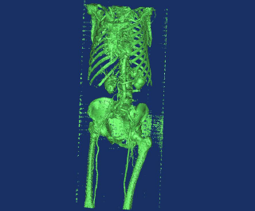
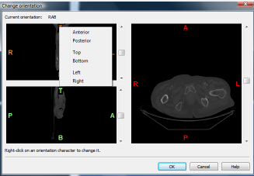
Geometry Reconstruction–
Materialise Mimics Software
1. The CT images were imported into Mimics software
2. The orientation of images was defined
3. An initial geometry was reconstructed using proper
semiautomatic algorithms provided by the Mimics
software
Aortic Arch
Additional choices

Slide 17
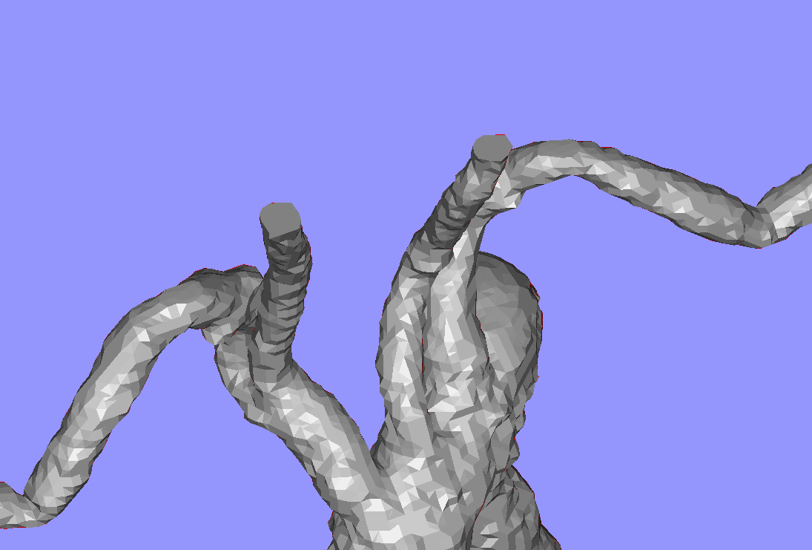
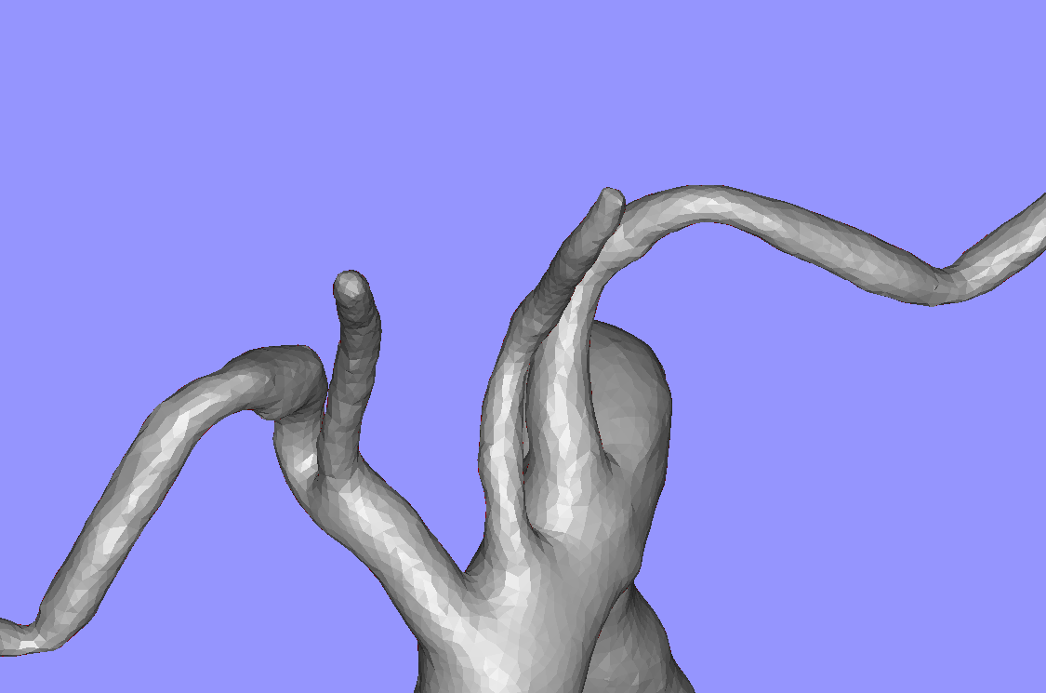
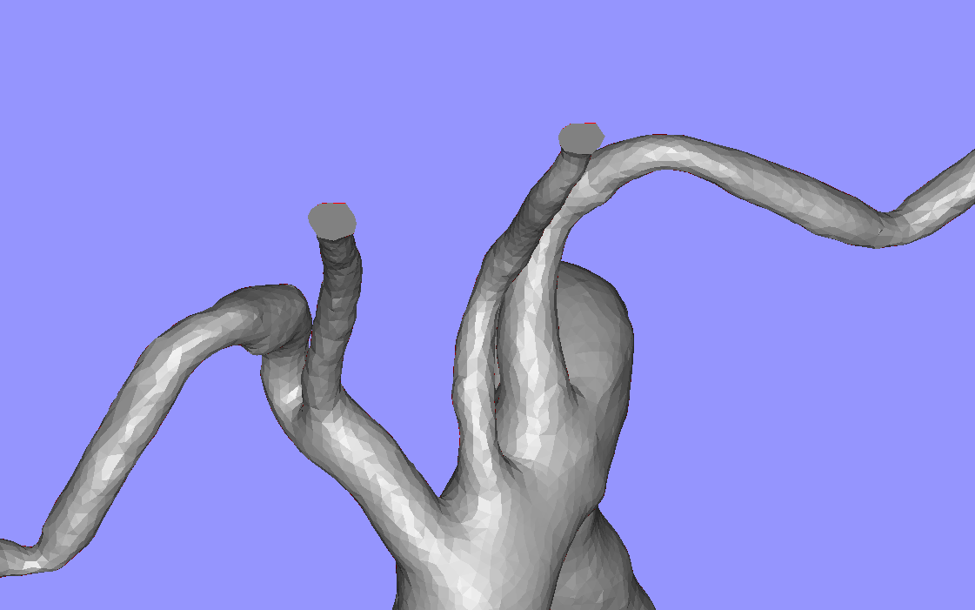
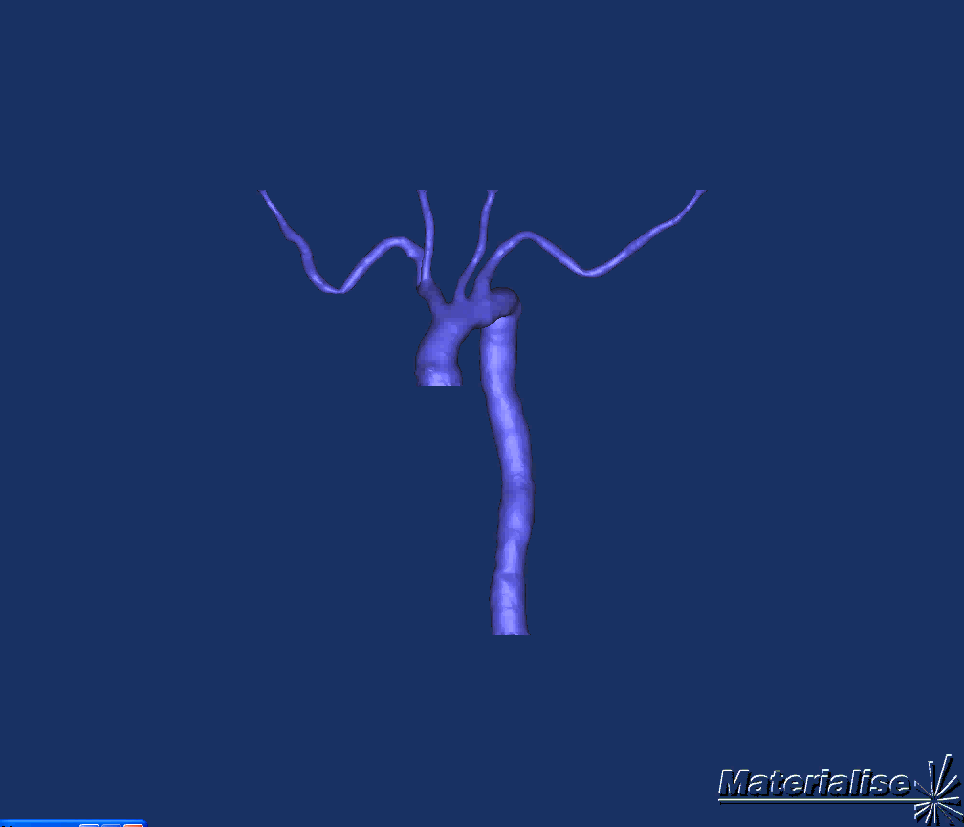
Smoothing process
Outflow Surface
Correct Smoothing
Incorrect smoothing

Slide 18
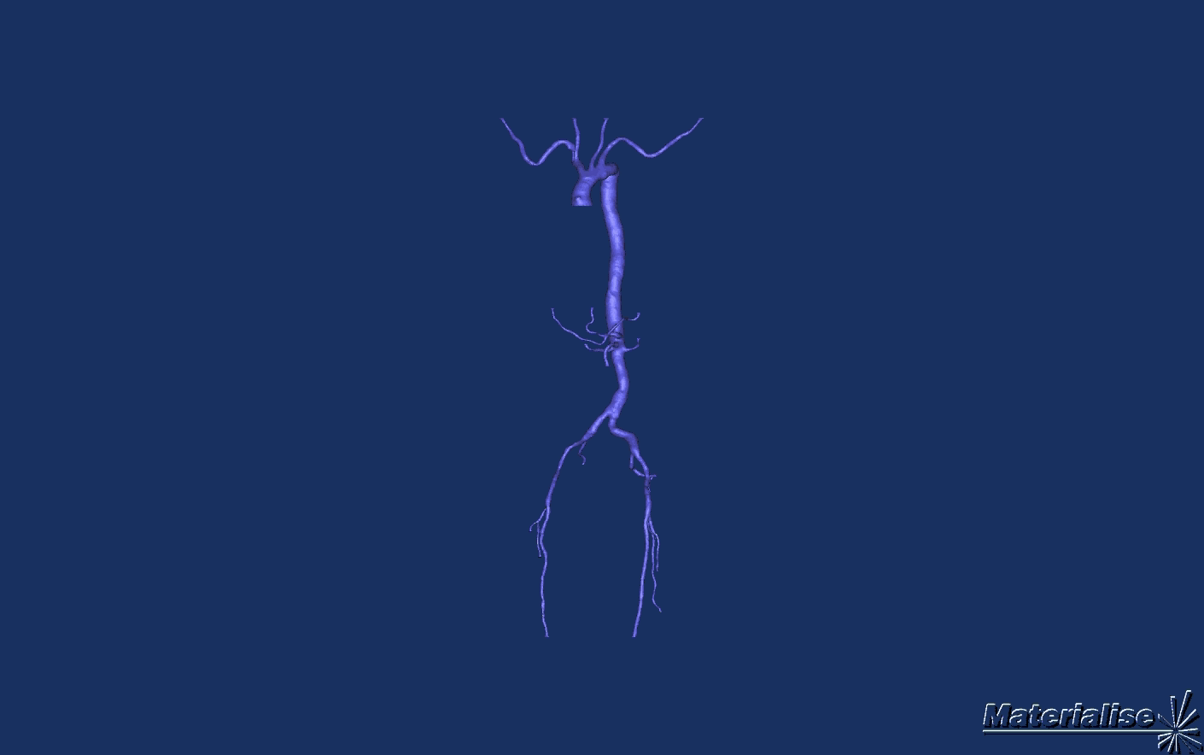
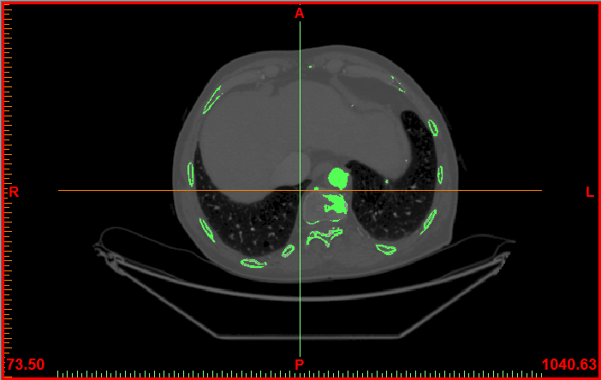
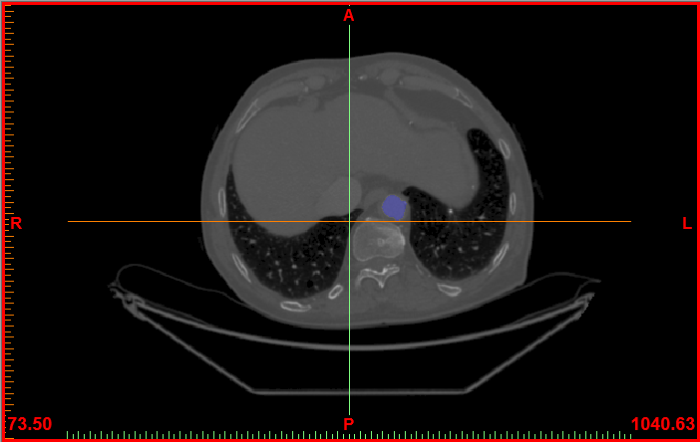
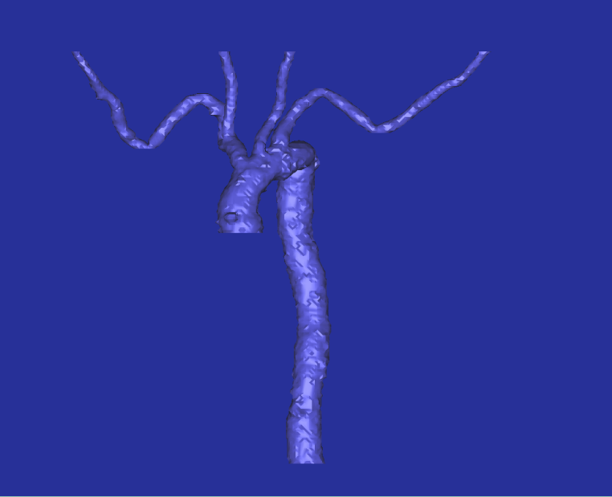
Geometry Reconstruction–
Materialize Mimics Software

Slide 19
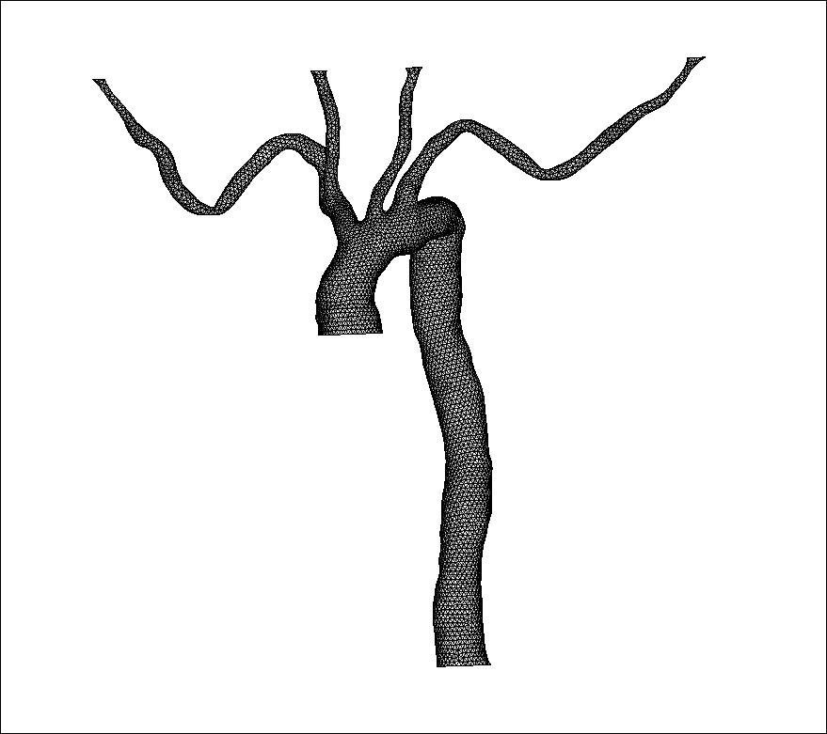
Geometry – Computational Grid
Computational Grid was produced using commercial software Gambit
Geometry | Number of computational cells
Aortic Arch | 80000 ( almost 200000 nodes)

Slide 20
Equations-Assumptions
The usual equations of mass and momentum conservation were solved for
transient,
three dimentional (3D),
incompressible,
isothermal and
laminar flow
Navier-Stokes equations

Slide 21
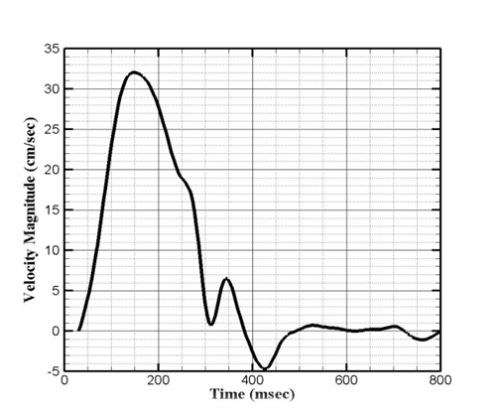
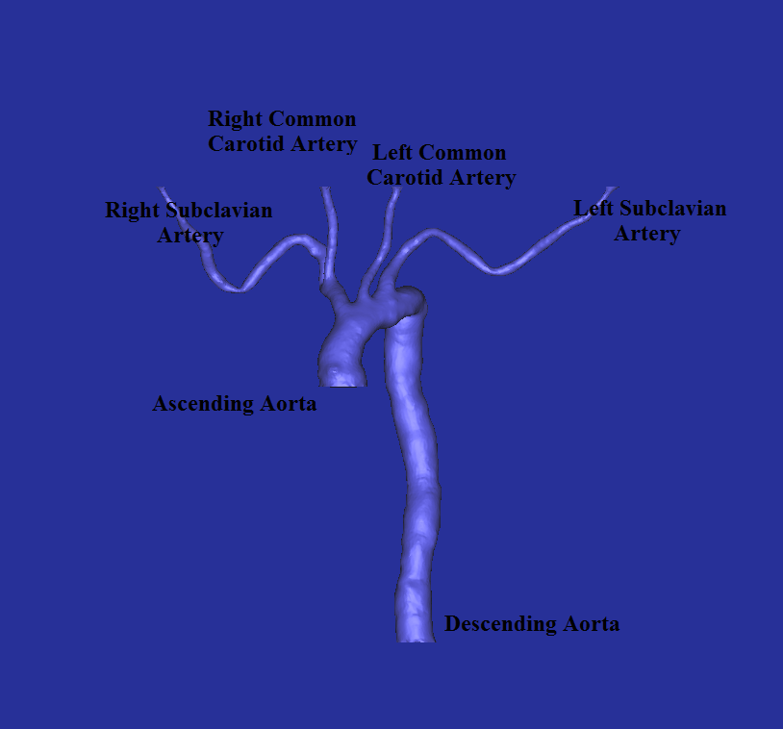
Boundary Conditions
Inlet pulse:
Outflows discharges:
Period T=800 msec
 | Q_{o}[%]
Inlet | 100%
Right common carotid artery | 3.71%
Right subclavian artery | 14.92%
Left common carotid artery | 3.22%
Left subclavian artery | 6.67%
Descending aorta | 71.48%

Slide 22
Blood Molecular Viscosity and WSS
Blood is examined as a non-Newtonian fluid obeying to the power law
(Soulis et al. 2008) and its density is set 1058 kg/m³.
According to non-Newtonian power law, blood apparent viscosity can be calculated as:
where S is the shear rate, T(K) and T_{o}(K) are the local and reference temperatures and k and n the Power law parameters
Thus, the instantaneous Wall Shear Stress was calculated as:

Slide 23
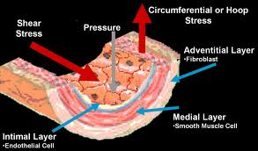
Wallace H. Coulter Laboratory
Cardiovascular Dynamics and Biomolecular Transport Laboratory
Zhong-Dong Shi, Rishi Mathura, and Henry Qazi

Slide 24
AWSS, AWSSV, OSI
The time-averaged WSS magnitude (AWSS) is defined as:
where is the instantaneous WSS (Pa) magnitude and T (sec) is the pulse period.
Another transient flow property, related with the wall, is the magnitude
of time-averaged WSS vector (AWSSV) defined as
Oscillatory Shear Index (OSI) monitors the differences between AWSS and AWSSV values.
-1
-1

Slide 25
Results for the patient specific arteries

Slide 26
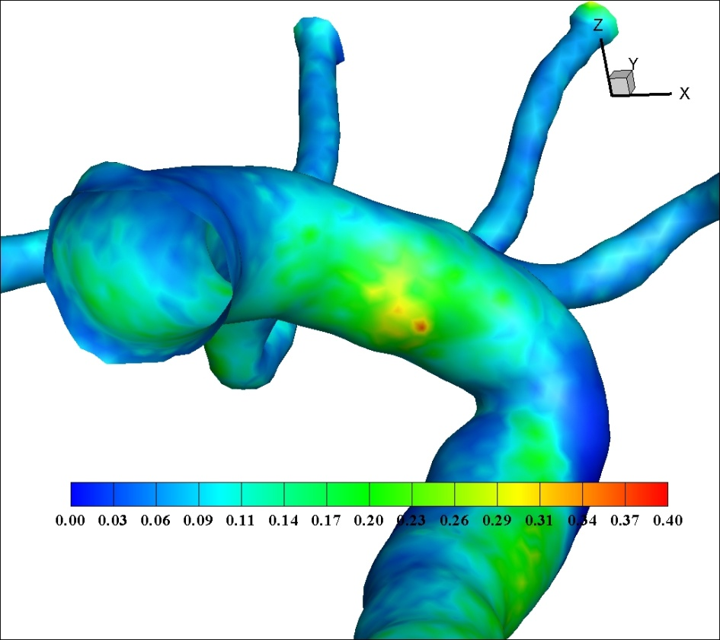
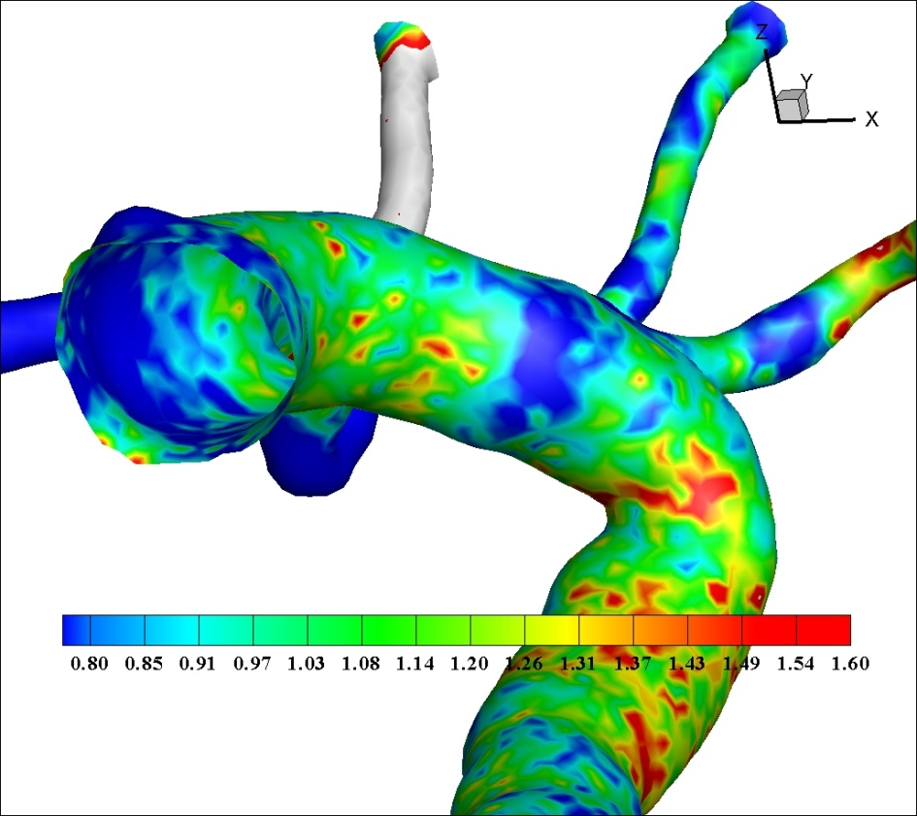
Results –AWSS & OSI
High OSI
Low AWSS

Slide 27
CHAPTER 3
NON-NEWTONIAN BLOOD FLOW

Slide 28
Many non-Newtonian models exist, but none of them is still universally accepted. In the current research work, seven non-Newtonian models plus the Newtonian one are compared in a real human LCA tree. These models are:
1) Newtonian,
2) Carreau (Cho et al., 1991),
3) Modified Cross Law (Carreau-Yasuda model),
4) Power Law (Cho et al., 1991),
5) Non-Newtonian Power Law (Sharma et al., 1992),
6) Generalized Power Law (Ballyk et al., 1994),
7) Casson (Fung, 1993),
8) Walburn-Schneck Law (Walburn et al. 1976).

Slide 29
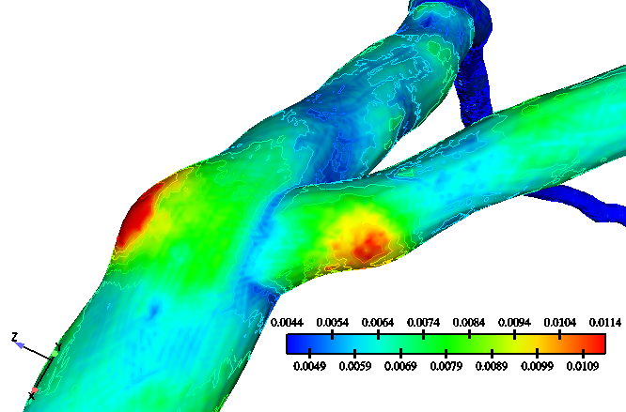
Contour plots of the Molecular Viscosity (kg/m-s) magnitude distribution
using non-Newtonian Power Law model

Slide 30
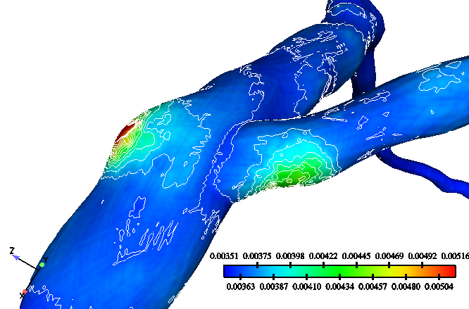
Contour plots of the Molecular Viscosity (kg/m-s) magnitude distribution using Modified Cross Law model

Slide 31
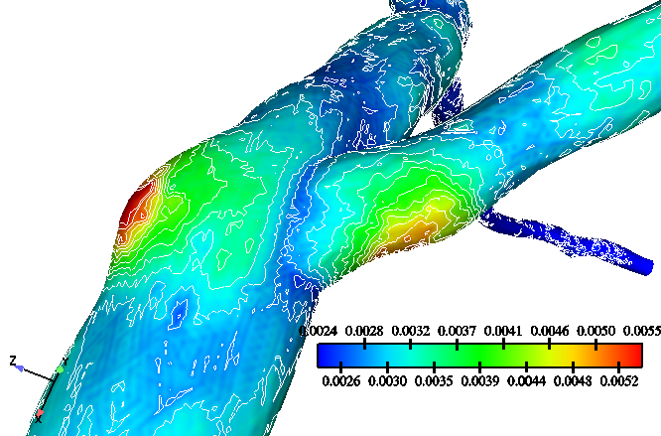
Contour plots of the Molecular Viscosity (kg/m-s) magnitude distribution using Walburn-Schneck Law model

Slide 32
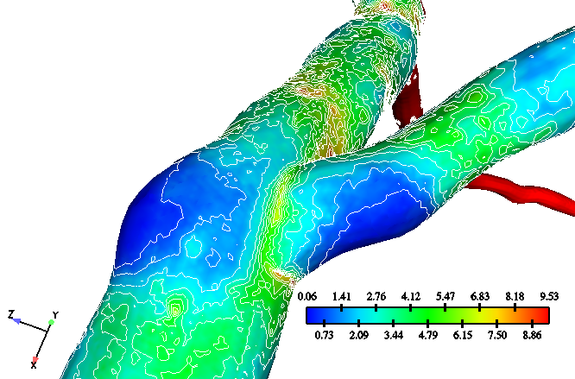
Contour plots of the Wall Shear Stress (WSS, N/m²) magnitude distribution using Newtonian Law model. Contour labels range from 1 to 15 and correspond to 15 colour levels shown in the bar

Slide 33
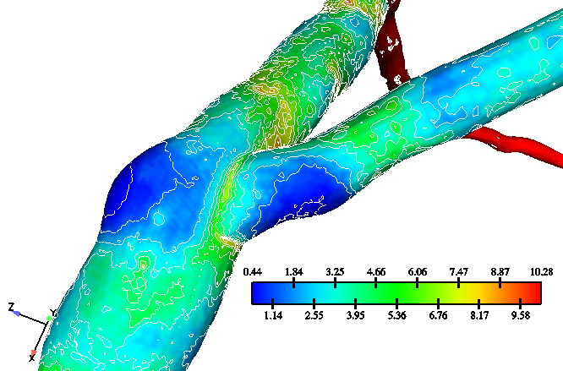
Contour plots of the Wall Shear Stress (WSS, N/m²) magnitude distribution using Carreau Law model

Slide 34
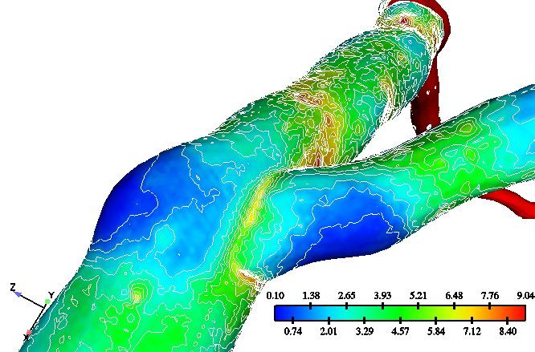
Contour plots of the Wall Shear Stress (WSS, N/m²) magnitude
distribution using Modified Cross Law model

Slide 35
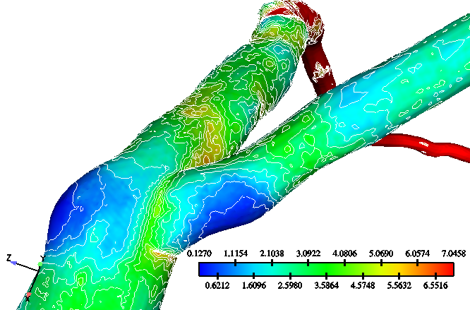
Contour plots of the Wall Shear Stress (WSS, N/m²) magnitude distribution using Power Law model

Slide 36
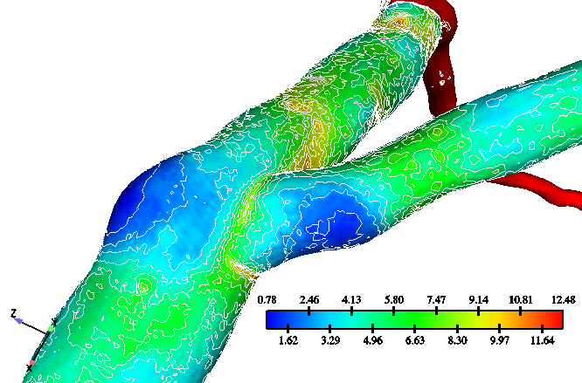
Contour plots of the Wall Shear Stress (WSS, N/m²) magnitude
distribution using non-Newtonian Power Law model

Slide 37
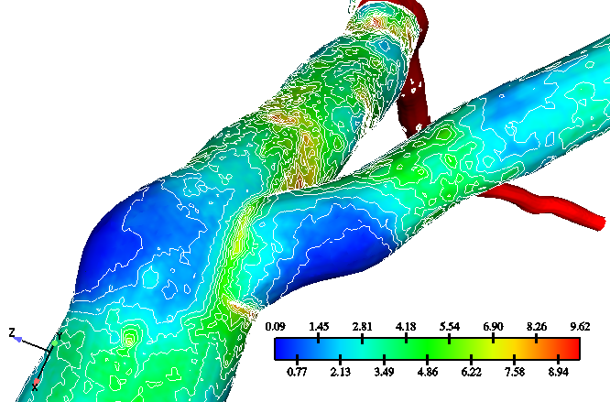
Contour plots of the Wall Shear Stress (WSS, N/m²)
magnitude distribution using Generalized Power Law model

Slide 38
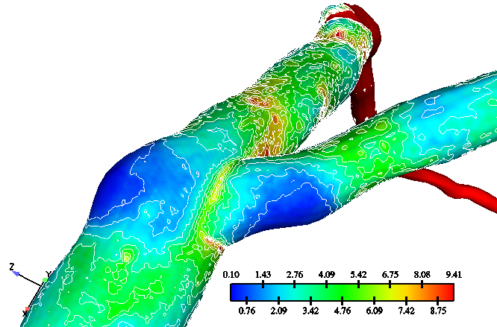
Contour plots of the Wall Shear Stress (WSS, N/m²) magnitude distribution using Casson Law model

Slide 39
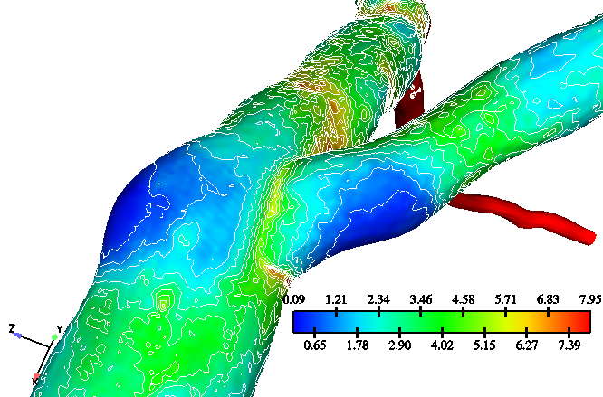
Contour plots of the Wall Shear Stress (WSS, N/m²) magnitude
distribution using Walburn-Schneck Law model

Slide 40
CHAPTER 4
NORMAL LEFTCORONARY ARTERY

Slide 41
Geometry, computational grid and flow equations for the Left Coronary Artery

Slide 42
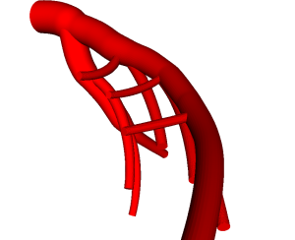
LCA Geometry

Slide 43
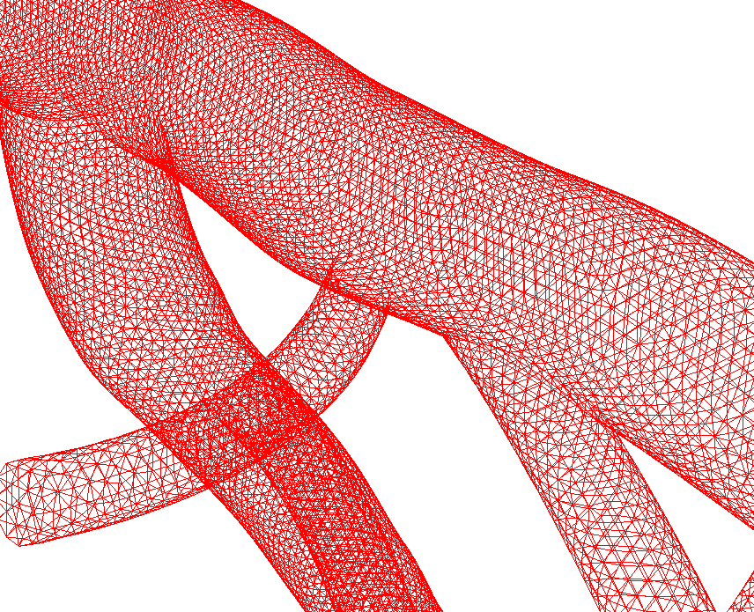
Computational grid

Slide 44
WSS and WSSG
The instantaneous Wall Shear Stress was calculated as:
The instantaneous Wall Shear Stress Gradient was calculated as:

Slide 45
ΔWSS and ΔWSSG
The instantaneous ΔWSS was calculated as:
The instantaneous ΔWSSG was calculated as:
r: stands for either FD or LW. b: stands for entire bifurcation.

Slide 46
Definition of Flow Divider (FD) and Lateral Walls (LW)
Main bifurcation
Flow divider (FD)
D1-S1 bifurcation
D2-S2 bifurcation
Lateral Walls (LW)

Slide 47
Areas covered by Flow divider (FD) and Lateral Walls (LW)
Flow divider (FD), covers an area of 3.15x10⁻⁵ m²
Lateral Walls (LW),
cover an area of 7.0x10⁻⁴ m²

Slide 48
Pulsewave
Systole
Diastole
Systole
Diastole

Slide 49
Results for the Left Coronary Artery

Slide 50
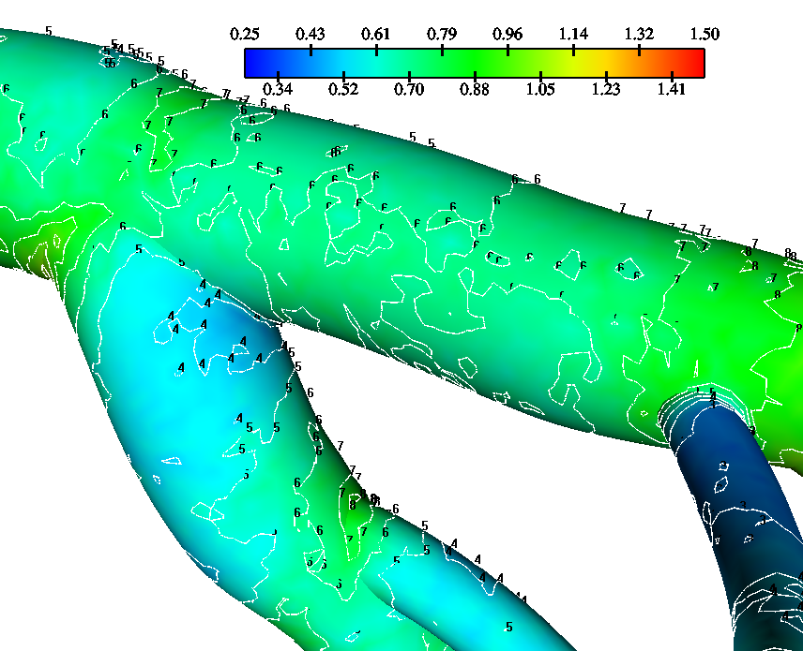
Wall Shear Stress (N/m2)
Time point A (15.0 msec)

Slide 51
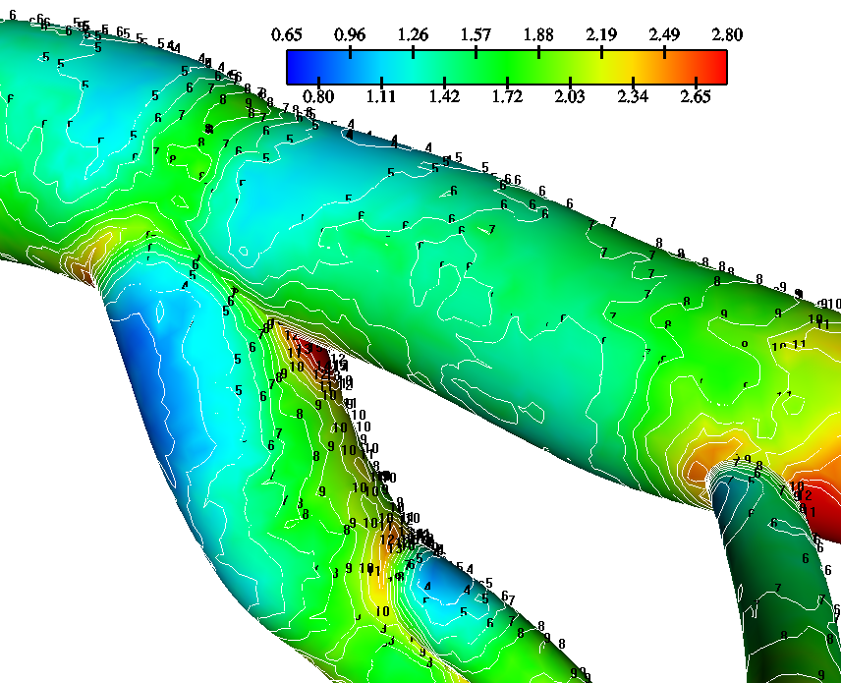
Wall Shear Stress (N/m2)
Time point B (150.0 msec)

Slide 52
Wall Shear Stress (N/m2)
Time point C (285.0 msec)

Slide 53
Wall Shear Stress (N/m2)
Time point D (385.0 msec)

Slide 54
Wall Shear Stress (N/m2)
Time point E (642.5 msec)

Slide 55
Minimum Wall Shear Stress (N/m2)
Main bifurcation,
FD: dashes,
LW: continuous lines
min WSS (N/m2)
3
2,5
2
1,5
1
0,5
0
0
100
200
300
400
500
600
700
800
900
1000
Time (msec)

Slide 56
Mean Wall Shear Stress (N/m2)
Main bifurcation,
FD: dashes,
LW: continuous lines
5
4,5
mean WSS (N/m2)
4
3,5
3
2,5
2
1,5
1
0,5
0
0
100
200
300
400
500
600
700
800
900
1000
Time (msec)

Slide 57
Maximum Wall Shear Stress (N/m2)
Main bifurcation,
FD: dashes,
LW: continuous lines
7,5
7
6,5
6
5,5
5
4,5
4
3,5
3
2,5
2
1,5
1
0,5
0
0
100
200
300
400
500
600
700
800
900
1000
Time (msec)

Slide 58
Minimum Wall Shear Stress (N/m2)
D1-S1 bifurcation,
FD: dashes,
LW: continuous lines
4
3,5
3
2,5
2
1,5
1
0,5
0
0
100
200
300
400
500
600
700
800
900
1000
Time (msec)

Slide 59
Mean Wall Shear Stress (N/m2)
D1-S1 bifurcation,
FD: dashes,
LW: continuous lines
7
6
5
4
3
2
1
0
0
100
200
300
400
500
600
700
800
900
1000
Time (msec)

Slide 60
Maximum Wall Shear Stress (N/m2)
D1-S1 bifurcation,
FD: dashes,
LW: continuous lines
max WSS (N/m2)
9
8
7
6
5
4
3
2
1
0
0
100
200
300
400
500
600
700
800
900
1000
Time (msec)

Slide 61
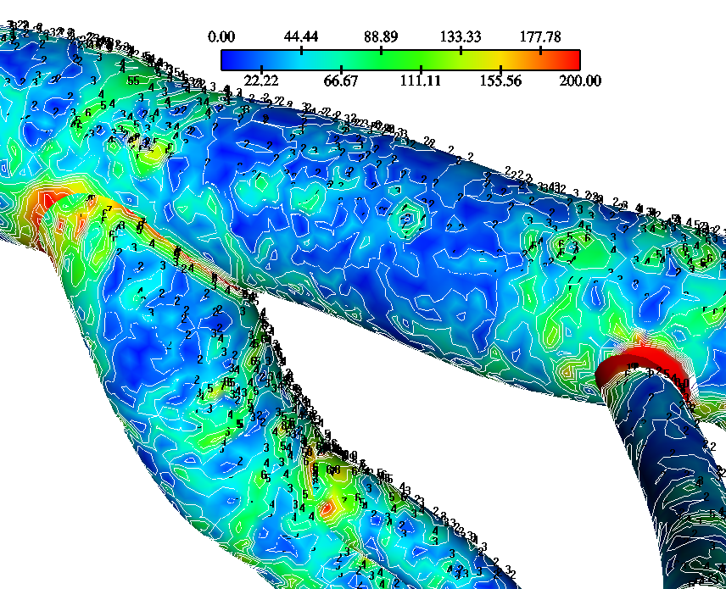
Wall Shear Stress Gradient (N/m3)
Time point A (15.0 msec)

Slide 62
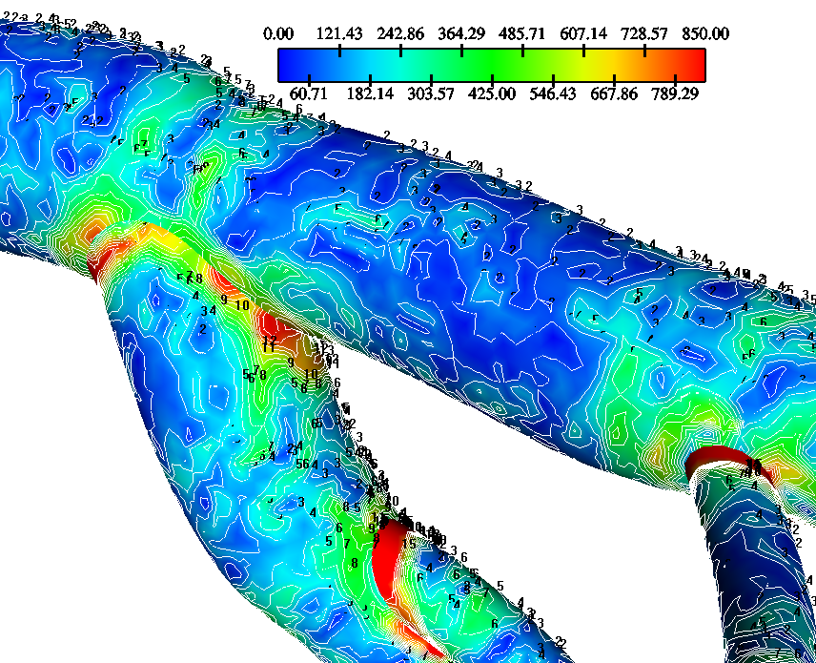
Wall Shear Stress Gradient (N/m3)
Time point B (150.0 msec)

Slide 63
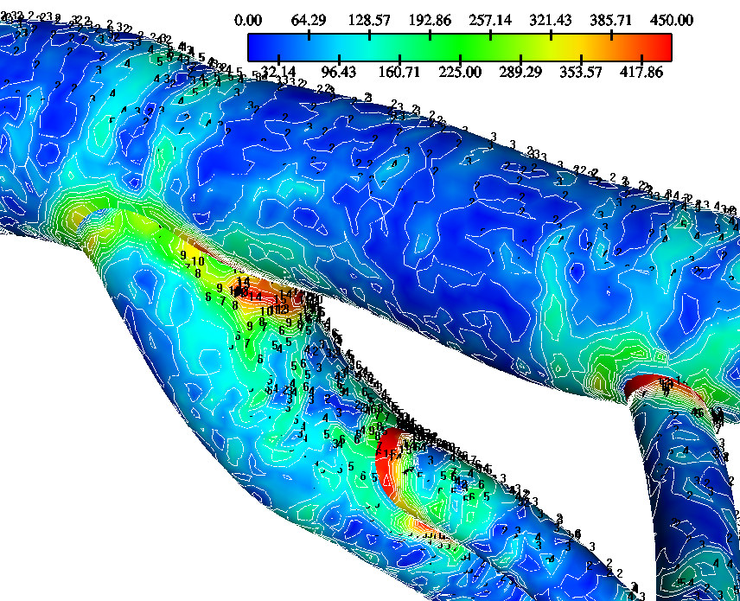
Wall Shear Stress Gradient (N/m3)
Time point C (285.0 msec)

Slide 64
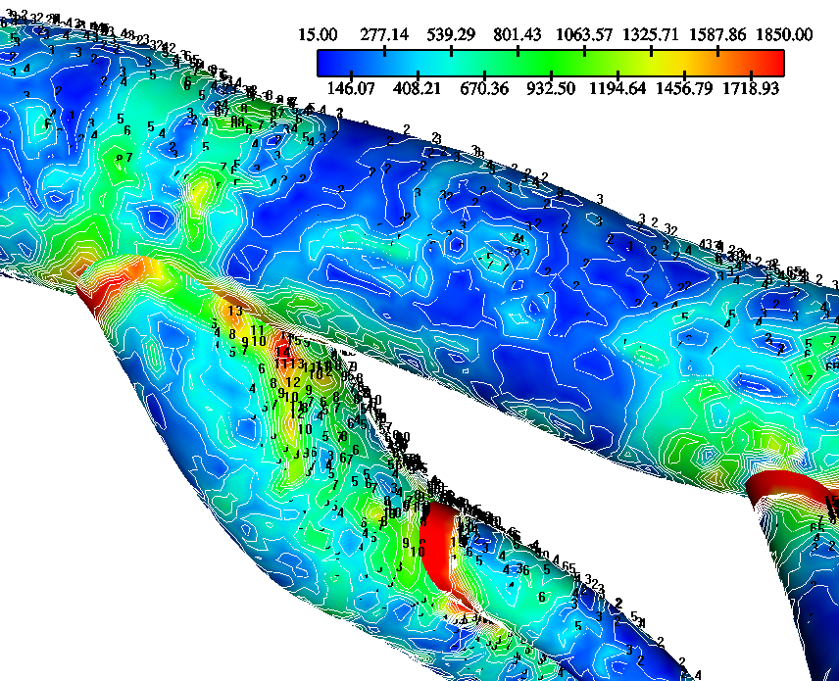
Wall Shear Stress Gradient (N/m3) Time point D (385.0 msec)

Slide 65
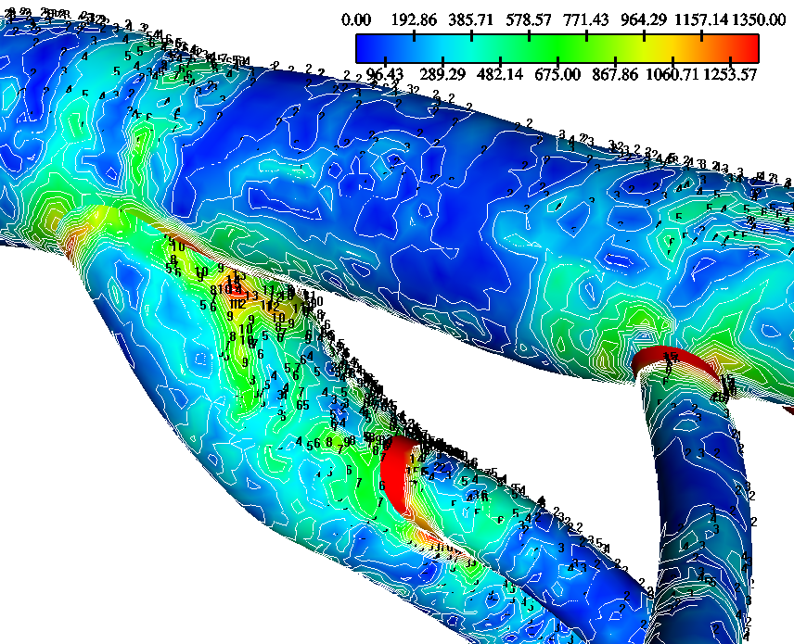
Wall Shear Stress Gradient (N/m3)
Time point E (642.5 msec)

Slide 66
Minimum Wall Shear Stress Gradient (N/m3)
Main bifurcation,
FD: dashes,
LW: continuous lines
min WSSG (N/m3)
250
225
200
175
150
125
100
75
50
25
0
0
100
200
300
400
500
600
700
800
900
1000
Time (msec)

Slide 67
Mean Wall Shear Stress Gradient (N/m3)
Main bifurcation,
FD: dashes,
LW: continuous lines
mean WSSG (N/m3)
1200
1100
1000
900
800
700
600
500
400
300
200
100
0
0
100
200
300
400
500
600
700
800
900
1000
Time (msec)

Slide 68
Maximum Wall Shear Stress Gradient (N/m3)
Main bifurcation,
FD: dashes,
LW: continuous lines
max WSSG (N/m3)
4500
4000
3500
3000
2500
2000
1500
1000
500
0
0
100
200
300
400
500
600
700
800
900
1000
Time (msec)

Slide 69
ΔWSS (N/m2) at the flow divider
Main bifurcation
FD: continuous lines,
LW: dashes
max WSSG (N/m3)

Slide 70
ΔWSSG (N/m3) at the flow divider
Main bifurcation
FD: continuous lines,
LW: dashes
max WSSG (N/m3)

Slide 71
CHAPTER 5
RIGHT CORONARY ARTERIES
(RCA, STENTED ARTERY, ARTERIAL WALL)

Slide 72
5.1 Right Coronary Arteries (RCA)

Slide 73
Geometry and computational grid for the Right Coronary Arteries

Slide 74
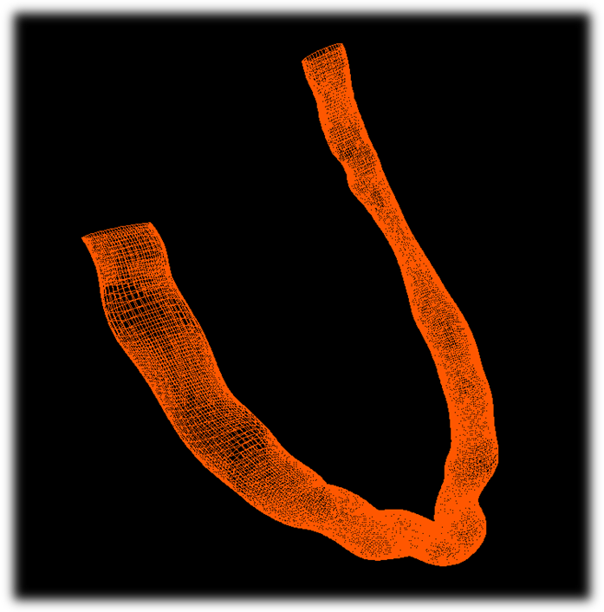
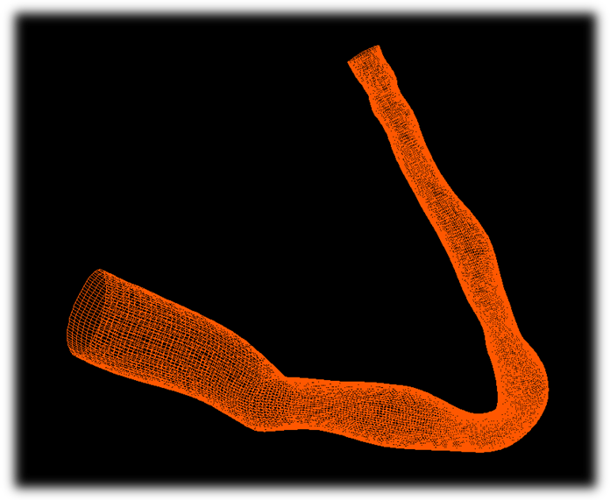
Computational grid
RCA Vessels No 1 and No 2

Slide 75
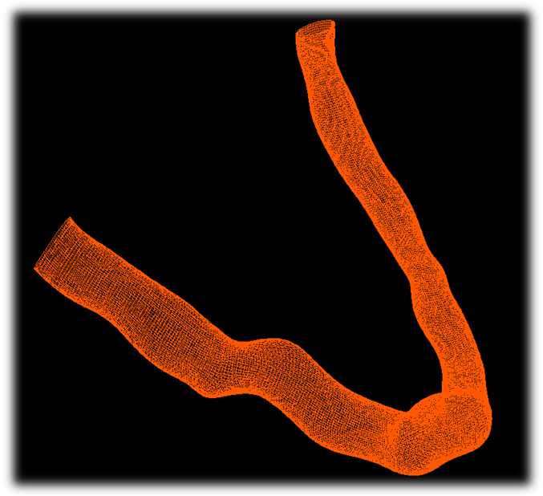
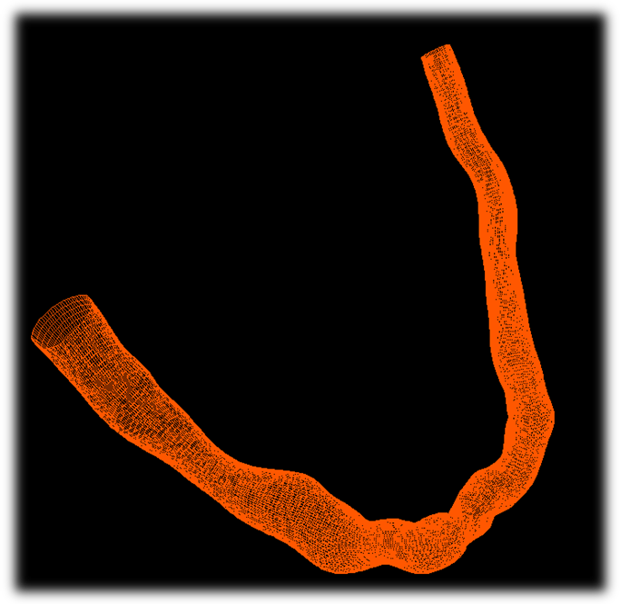
Computational grid
RCA Vessels No 3 and No 4

Slide 76
Results for the Right Coronary Arteries

Slide 77
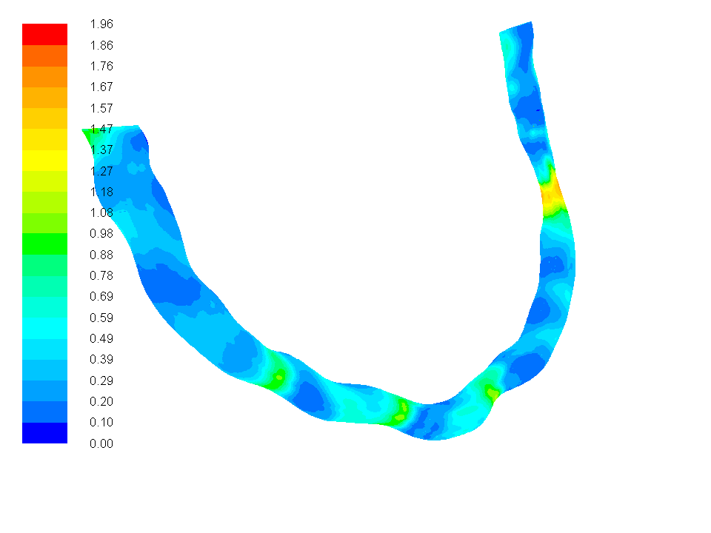
AWSS (N/m2) No1 RCA
High OSI
Low AWSS

Slide 78

AWSSV (N/m2) No1 RCA
High OSI
Low AWSS

Slide 79

OSI No1 RCA
High OSI
Low AWSS

Slide 80

OSI vs WSS (N/m2)
High OSI
Low AWSS

Slide 81

OSI vs AWSSV (N/m2)

Slide 82

AWSSV(N/m2) vs AWSS(N/m2)

Slide 83


Wall Shear Stress (N/m2)
RCA Vessels No 1 and No 2

Slide 84


Wall Shear Stress (N/m2)
RCA Vessels No 3 and No 4

Slide 85


Infiltration velocity (m/s)
RCA Vessels No 1 and No 2

Slide 86

Normalized luminal surface LDL concentration Cw/Co contours of the RCAs. Infiltration velocity and endothelial permeability coefficient are shear dependent

Slide 87
Area Averaged LDL concentration over RCAs using various Vw and K
 | Vessel 1 C_{w}/C_{o} | Vessel 2 C_{w}/C_{o} | Vessel 3 C_{w}/C_{o}
V_{w}=0.6x10⁻⁸ m/s K=2.0x10⁻¹⁰ m/s | 1.030 | 1.041 | 1.046
Shear dependent V_{w} and K | 1.075 | 1.117 | 1.125
 | Vessel 4 C_{w}/C_{o} | Vessel 5 C_{w}/C_{o} | Vessel 6 C_{w}/C_{o}
V_{w}=0.6x10⁻⁸ m/s K=2.0x10⁻¹⁰ m/s | 1.036 | 1.033 | 1.029
Shear dependent V_{w} and K | 1.097 | 1.089 | 1.075

Slide 88

RCA Vessel No 1
WSS (N/m2) magnitude. Vw and K are shear dependent

Slide 89

RCA Vessel No 1
Water infiltration velocity Vw (m/s). K is shear dependent

Slide 90

RCA Vessel No 1
Endothelial permeability K (m/s). Vw is shear dependent

Slide 91
5.2 Stented artery

Slide 92
Stent insertion

Slide 93

Stent is inserted into the arterial vessel where the atheromatic plaque is located
Medical Guideline Systems

Slide 94

Few seconds later, the stent is deployed
Medical Guideline Systems

Slide 95

Stent final position
Medical Guideline Systems

Slide 96
Geometry and computational
grid for the stented artery

Slide 97

Stent geometry of the fully deployed artery. Front and rear view projected into a single plane.

Slide 98

Stent struts are 50.0 % embedded into the arterial wall

Slide 99

The computational grid is comprised from four quadrants. One quadrant is tested for CPU time economy

Slide 100
Results for the stented coronary artery

Slide 101

Velocity (m/s) streamlines near to endothelium of the stented artery

Slide 102

Velocity (m/s) streamlines near to endothelium of the stented artery

Slide 103

Velocity (m/s) streamlines near to endothelium at the very end region of the stented artery

Slide 104

Velocity (m/s) streamlines near to endothelium at the mid portion region of the stented artery

Slide 105

WSS (N/m²) contours of the artery
(stent and endothelium)

Slide 106

WSS (N/m²) contours of the artery (stent and endothelium). Enlarged view

Slide 107

WSS (N/m²) contours on struts of the artery. Front and rear view projected in a single plane

Slide 108

WSS (N/m²) vectors of the artery
(stent and endothelium)

Slide 109

WSS (N/m²) vectors of the artery (stent)

Slide 110

Luminal surface LDL concentration C_{w}

Slide 111

Luminal surface LDL concentration C_{w}

Slide 112
5.3 Arterial wall

Slide 113
Geometry and computational
grid for the arterial wall

Slide 114

Various CT slice scans were used for the reconstruction of the three-dimensional segments. The layered masks were segmented in Mimics software with different colours for each CT image slice. The arterial wall is shown in red with lumen in blue colour.
Masks in color for a typical CT slice

Slide 115

Reconstructed human thoracic aorta 3D

Slide 116


Due to unsmoothed surfaces, the geometry had to be improved by rebuilding the surfaces that constitute the boundary surfaces. This action was necessary for the subsequent computational analysis and it was achieved through Rhinoceros 4.0 software.
Endothelium
Arterial wall
Reconstruction of arterial wall
Shaded geometry

Slide 117
Following the completion of the 3D reconstruction geometry, the computational mesh generation is the natural following step. Towards this end, the constructed geometry is imported into Gambit software. The number of mesh nodes used was 1.825.113.
Shaded geometry.
Lumen and arterial wall
Creation of mesh

Slide 118
Flow field and boundary conditions

Slide 119

Interfacial coupling through J_{v} και J_{s} (Olgac U. et al, 2008)

Slide 120
Applied pulsewave into the lumen entrance

Slide 121
Results for the arterial wall

Slide 122

Wall Shear Stress (Pa) at the luminal side after 61.0 msecs

Slide 123


Normalized LDL concentration at the luminal side after 61.0 msecs

Slide 124

Normalized LDL concentration within the arterial wall
(close to endothelium) after 61.0 msecs (one view)

Slide 125


Normalized LDL concentration within the arterial wall
(close to endothelium) after 61.0 msecs (second view)

Slide 126


Normalized LDL concentration at an arbitrary
wall cross-section after 61.0 msecs

Slide 127
WSS (Pa) at luminal side after 400.0 msecs

Slide 128

Normalized LDL concentration at the luminal side after 400.0 msecs

Slide 129

Time-averaged normalized LDL at the lumen side

Slide 130

Time-averaged normalized LDL concentration
within the arterial wall (close to endothelium)

Slide 131

Time-averaged LDL concentration at an arbitrary cross-section

Slide 132
CHAPTER 6
AORTA

Slide 133
Computational grid of normal Aorta

Slide 134

WSS (N/m2) in Aorta

Slide 135

WSS (N/m2) in Aorta

Slide 136
LDL in Aorta

Slide 137
LDL in Aorta

Slide 138
CHAPTER 7
FLUID STRUCTURE INTERACTION

Slide 139
Computer tomography

Slide 140

Contouring of vessel section

Slide 141

Contour sections

Slide 142

AAA Model. 3D Reconstruction

Slide 143

AAA Model. Computational Grid

Slide 144

AAA model. Von Mises Stress (N/m2) under 120.0 mm Hg

Slide 145

AAA model. Displacement (mm) (radial-like) under 120.0 mm Hg

Slide 146

AAA model. Von Mises Stress (N/m2) under 180.0 mm Hg

Slide 147

AAA model. Displacement (mm) (radial-like) under 180.0 mm Hg

Slide 148

AAA model. Von Mises Stress (N/m2) under 240.0 mm Hg

Slide 149

AAA model. Displacement (mm) (radial-like) under 240.0 mm Hg

Slide 150
CHAPTER 8
CONCLUSION

Slide 151
The current computational analysis results quantify
a) the WSS and its impact on LDL concentratio
b) the fluid structure interaction

Slide 152
The velocity vector oscillates and at the same time alters its direction.
    High OSI values locate in regions with low AWSS.
    Low AWSS and high OSI values nearly collocate.
    The values of AWSS-OSI, are affected from local conditions such as geometry
    curvature, instantaneous and time-averaged WSS and global parameters such as
    velocity variation in time and others.
    Regional differences between AWSS magnitude and OSI may answer the question as to where atherosclerotic lesions predominately develop and progress at specific aortic regions.

Slide 153
    WSS plays an important role in the wall concentration of the LDL.
    Increased permeation of LDL concentration at specific regions is observed.
    Prone to plaque development are flow regions located at specific intersections where increased LDL concentration is observed.
    The paths of the velocity in the proximity to the endothelium region might be the most important factor for elevated LDL concentration.
    Increased blood pressure increases arterial wall stress.
    Vessel geometry complexity gives rise to increased wall stress.

Slide 154
The luminal surface LDL concentration at the arterial wall is flow-dependent with local variations due to geometric features.
The relationship between WSS and luminal surface concentration of LDL indicates that LDL is elevated at locations where WSS is low.

Slide 155
The results also indicate that artery walls are exposed to a cholesterolemic
environment although the applied mass and flow conditions refer to normal mass-
flow conditions.
It is the permeability of the endothelium, which mainly determines the final
amount passing through the wall.
Regions where the WSS is low and the luminal surface LDL concentration is high, the flux across the endothelium is increased rendering these regions as atherogenic-prone areas. So high LDL concentration in the arterial wall occurs in regions with high luminal side LDL concentrations.
The LDL concentration within the arterial wall is smaller (nearly 18-20 times) than at the luminal side of the endothelium.
LDL concentration values decrease within the arterial wall from regions close to endothelium side towards adventitia.

Slide 156
Thank you for your attention

